Slide 1
Concurrent and Parallel Systems Processes and threads
Dr Sergio Davies <sergio.davies@shu.ac.uk>
Department of computing
Sheffield Hallam University
30 September 2022

Slide 2
Topics
Last topic: Meaning of “Concurrency”, with some real life examples and applicability to world of computing.
Today:
Examples in computing
Terminology: Processes, threads, etc.
Differentiation between processes and threads
How scheduling gives raise to non-determinism
Create, run and terminate a thread in C++

Slide 3
Examples in computing
Simulation/modelling of naturally concurrent systems (such as traffic)
Modelled entities evolve concurrently with each other
Client/server systems
Multiple clients interact with the server concurrently
Graphical user interfaces
UI elements updated concurrently with background computation
Any parallel computation
Parallel tasks execute concurrently (possibly on different processors)
Most operating systems
Multitasking OSs can execute processes concurrently

Slide 4
Terminology
What is the difference between:
Process
Thread
Actor
Agent

Slide 5
Terminology
What is the difference between:
Process
Thread
Actor
Agent
In computer science these terms are (more or less) equivalent in the context of concurrency

Slide 6
Terminology
Term | Context | Meaning
Process | General | Series of actions or operations conducing to an end [Merriam-Webster – Process]
 | Computer Science | In computing, a process is the instance of a computer program that is being executed. [Wikipedia – Process (computing)]
Thread | General | a line of reasoning or train of thought that connects the parts in a sequence (as of ideas or events) [Merriam-Webster – Thread]
 | Computer Science | Independent sequence of computation within a process that shares its resources with the other threads in the same process
Actor | General / Theatre / Movie | a person who plays the part of a character in a movie or play [Cambridge Dictionary – Actor]
 | Computer Science | Independent computation interacting with other actors by message passing. NOT by sharing memory
Agent | MI6 | James Bond
 | General | One who is authorized to act for or in the place of another [Merriam-Webster – Agent]
 | Software | Autonomous software component interacting with other agents

Slide 7
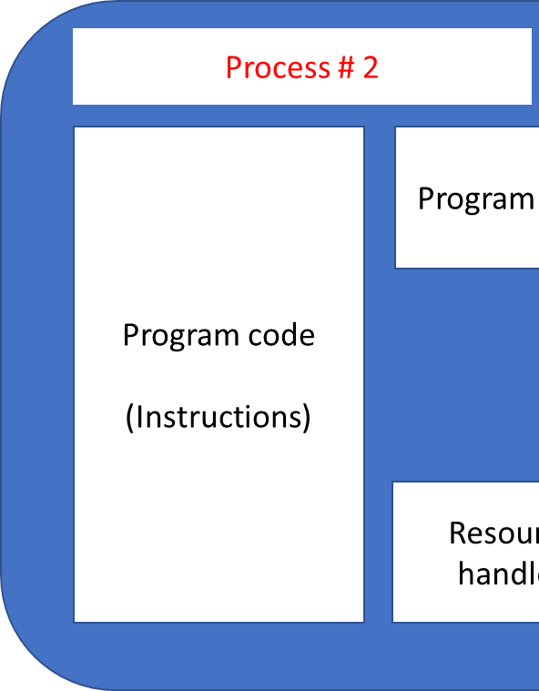
Processes v Threads
Processes
Process # 1
Program code
(Instructions)
Program state
Program data
Resource handles

Slide 8
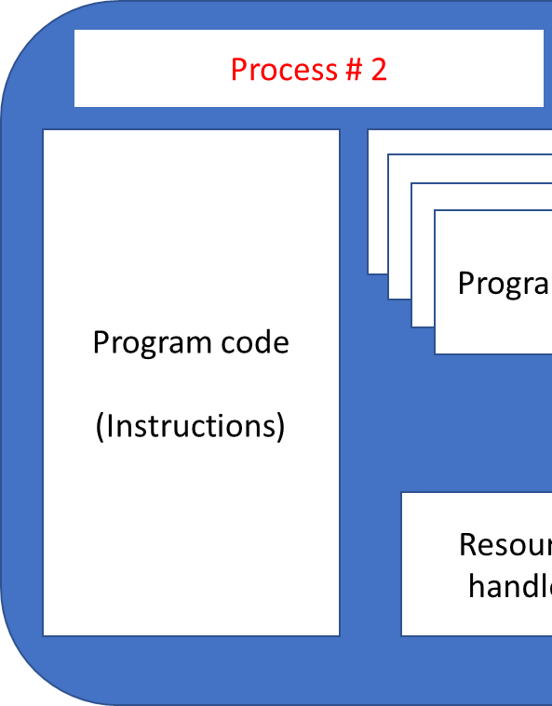
Processes v Threads
Threads
Process # 1
Program code
(Instructions)
Program state
Program data
Program state
Program state
Program state
Resource handles

Slide 9
Comparison
Creating / deleting a process requires:
Creating / deleting program code area
Creating / deleting data code area
Creating / deleting resource handle area
Creating / deleting program state area
Creating / deleting a thread requires:
Creating / deleting program state area
Creating a new process is computationally more expensive than creating a new thread within a process;
Two threads have the same environment and can use common variables to communicate;
Two processes need to use shared memory, sockets or IPC routines to communicate;

Slide 10
Process states
Two type of processes
CPU-bound: mainly performs operations on the CPU;
I/O-bound: mainly performs I/O operations;
New (spawning)
Runnable
Running
Dead
Waiting on I/O

Slide 11
Thread states
Within a process
Two type of threads
CPU-bound: mainly performs operations on the CPU;
I/O-bound: mainly performs I/O operations;
New (spawning)
Runnable
Running
Dead
Waiting on I/O

Slide 12
Process scheduler
Selects which process or thread is executed by the CPU for a slice of time (in the order of milliseconds)
When slice expires, the process returns in “runnable” state and the next process is executed
If the process waits for I/O it is removed from the CPU and placed in “waiting for I/O” state
OS
P #3
P #2
P #4
Scheduler
P #1
P #5

Slide 13
Process scheduler
In case of multiple CPUs, multiple processes can be selected
E.g. 2 CPUs:
OS
P #3
P #2
P #4
Scheduler
P #1
P #5

Slide 14
Thread scheduler (user-level)
Within a single process, selects which thread is being executed for a slice of time (again, order of milliseconds)
When slice expires, the thread returns in “runnable” state and next thread is executed
If the process waits for I/O then it is removed from the CPU and placed in “waiting for I/O” state
Process #5
OS
P #3
T #2
P #2
P #4
Scheduler
Scheduler
P #1
P #5
T #1
T #3

Slide 15
Thread scheduler (user-level)
In case of multiple CPUs, these cannot be used to run concurrently multiple threads within the same process, but only different processes altogether;
E.g. 2 CPUs – cannot schedule two threads from same process
Process #5
OS
P #3
T #2
P #2
P #4
Scheduler
Scheduler
P #1
P #5
T #1
T #3

Slide 16
Thread scheduler (system-level or kernel-level)
All process and thread entities are known to the OS and each thread can be scheduled independently;
E.g. 4 CPUs
OS
P #2
T #1
P #2
T #2
P #2
T #3
P #1
T #1
P #3
T #1
Scheduler
P #1
T #2
P #3
T #2

Slide 17
Nondeterminism
What happens with this code? What is the expected output?
void print(std::string message) {
for (int i = 0; i < 10; i++) {
std::cout << message;
std::this_thread::sleep_for(std::chrono::milliseconds(50));
} }
int main() {
std::thread t1(print, "Hello world!\n");
std::thread t2(print, "Goodbye!\n");
t1.join(); t2.join();
return 0;
}

Slide 18
Code analysis
Let’s analyse the code in the previous slide – start from “main” function
1 - Spawns two threads, passing to each a pointer to the function to execute and a string with the message to be printed:
std::thread t1(print, "Hello world!\n"); std::thread t2(print, "Goodbye!\n");
2 - Stops the execution of the main thread until threads t1 and t2 are terminated:
t1.join(); t2.join();

Slide 19
Code analysis
Each of the two threads will execute this function:
void print(std::string message) {
for (int i = 0; i < 10; i++) {
std::cout << message;
std::this_thread::sleep_for(
std::chrono::milliseconds(50)); }}
So each thread will print a message ten times

Slide 20
Run example – ex1
What output were you expecting?

Slide 21
Code analysis
How many threads are “runnable” at maximum in this code?
Where does the source of indeterminism come from?
It is not possible to assume anything about the relative timing of the three threads running in this software

Slide 22
Topics
Terminology: Process, thread, etc.
Differentiation between processes and threads
How scheduling gives raise to non-determinism
Create, run and terminate a thread in C++

Slide 23
Threading primitives
To launch a new thread to execute a function: template <class Fn, class... Args> thread::thread (Fn&& fn, Args&&... args); Fn: pointer to the function to execute; Args: parameters to the function;
To wait for the termination of a thread: void thread::join();

